Slide 1
APACHE PIG and HIVE
By
Navya Alapati
Pujitha Reddy Koppurapu
CSC 244
Professor: DR. YING JIN

Slide 2

AGENDA
Definitions
Architecture of PIG and Hive
Installation
Companies using PIG and Hive
Comparative Analysis
Conclusion
Demo

Slide 3


Slide 4
Hadoop
Hadoop is a framework that was created as an alternative to conventional database systems to:
Process large number of datasets.
Analyze
Store and retrieve

Slide 5
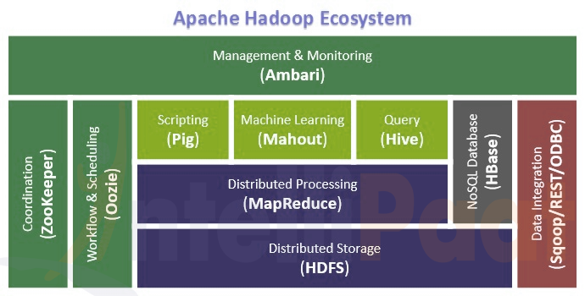

Slide 6
Hadoop Ecosystem
HDFS – Hadoop Distributed File System
Apache Hive
Apache Pig
MapReduce
HBASE
YARN – Yet Another source Navigator

Slide 7
Apache HIVE
Developed by Facebook
Founded by Jeff Hammerbacher
Apache Hive is a data warehouse software project built on top of Apache Hadoop for providing data query and analysis
HiveQL as SQL like declarative language

Slide 8
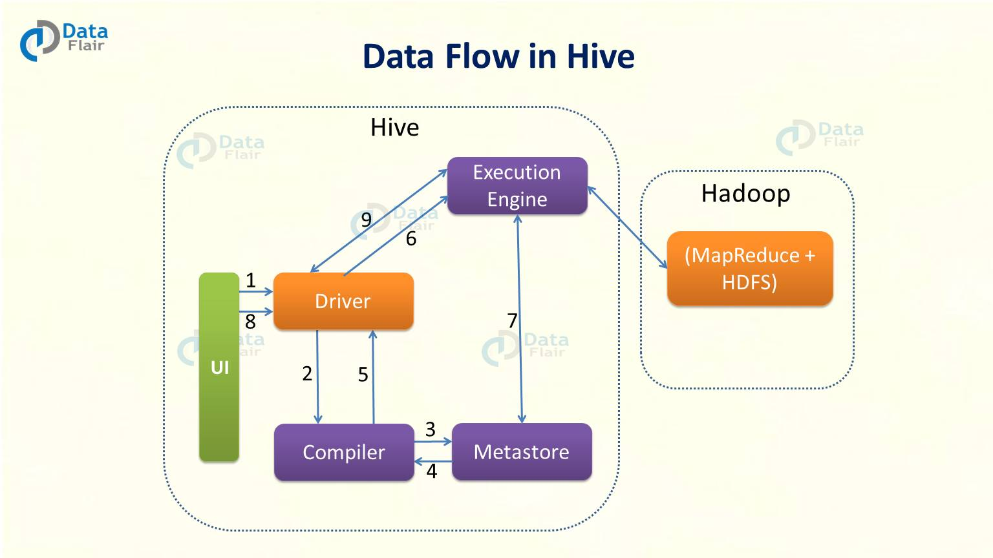
Apache HIVE Architecture

Slide 9
Apache HIVE Architecture
UI: Interface for clients where queries and different operations are submitted to the system
Driver: Driver part will receive the queries next
Compiler: performs analysis on the different query blocks, query expressions and query parsing
Meta Store: Hive chooses repetitive database servers to store the schema or MetaData of tables, databases, columns in a table and their datatypes
Execution Engine: Execution Engine process the query and generates the results
HDFS: the data storage techniques to store data in file system

Slide 10
Apache PIG
Developed by Yahoo
Apache Pig is a platform for analyzing large data sets that consists of a high-level language for expressing data analysis programs
Key Properties: Ease of programming, Optimization opportunities, Extensibility
Operations: Reading, Joining, Filtering

Slide 11
Apache PIG Architecture

Slide 12
Apache PIG Architecture
Parser: Parser basically checks the syntax of the script, does type checking and other miscellaneous checks
Optimizer: optimizer carries out future such and push down and projection
Compiler: The optimized logical plan is complied by the compiler into a series of MapReduce jobs
Execution Engine: The result is provided ones these MapReduce jobs are executed on Hadoop

Slide 13
Installation of PIG
Pre requisite is Java and Hadoop installation.
We first download the Pig tar file by using command: wget http://www-us.apache.org/dist/pig/pig-0.16.0/pig-0.16.0.tar.gz
Install latest virtual box.
We install cloudera latest version.
Open Hue editor in cloudera.
To select PIG editor in Hue, go to Query>Editor>Pig

Slide 14
Installation of HIVE
Pre requisite is java and Hadoop installation.
Download hive from http://apache.petsads.us/hive/hive-0.14.0/.
In cloudera, open Hue editor.
To open Hive editor in Hue go to Query>Editor> Hive

Slide 15
Companies Using Pig
AOL uses PIG for analytics and batch data processing for various applications.
PIG is also used in Mendeley to help their business analytics, feature feedback, user experience evaluation and more.
Salesforce also uses PIG to develop easy custom UDFs.
Twitter uses PIG extensively to process usage logs, mine tweet data, and more.
Stanford University also uses PIG to power an emerging interface to these archives for social scientists.
PIG is widely used by PayPal to analyze transaction data in order to prevent fraud.

Slide 16
Companies Using Hive
HIVE is used for Trending topics, Hot Wikipedia Topics, Served Fresh Daily. They use Hive for log data normalization and building sample datasets for trend detection R&D.
In NexR, HIVE is used for replacing Oracle DW, big data analysis and integrating R.
SaaSPulse uses HIVE for analytics, machine learning and customer interaction analysis of web applications.
TaoBao uses HIVE for data mining, internal log analysis and ad-hoc queries. They also do some extensively developing work on Hive.

Slide 17
Comparative Analysis of PIG and HIVE

Slide 18
Comparative Analysis of PIG and HIVE

Slide 19
Comparative Analysis of PIG and HIVE

Slide 20
Apache HIVE Demo

Slide 21
Apache PIG Demo

Slide 22
Conclusion
Based on the business requirements and type of data, Apache Pig or Hive is selected for the business uses.
As we have seen in previous section, PIG and HIVE have some similarities and differences. And also both have their Pros and Cons of using them. But still they are widely used among all the industries and companies as they have many uses.

Slide 23
Thank you

